Slide 1

Scrum 101
An Introduction to the Science Behind Scrum
Notes:
Add digital playbook education module #3

Slide 2
Course Objectives
At the end of this session, you will be able to:
Identify the 3 core roles of a scrum
List the 6 sprint ceremonies
Define and produce the 6 scrum artifacts

Slide 3
Lessons
Introduction to Scrum
Scrum Roles
Scrum Ceremonies
Scrum Artifacts

Slide 4
The Flow Through the Digital Delivery Lifecycle
Design with Users
Iterate and Improve Frequently
Work in the Open by Default
Use Open Standards and Solutions
Address Security and Privacy Risks
Ideation
Delivery
Discovery
Release
Build in Accessibility from the Start
Empower Staff to Deliver Better Services
Be Good Data Stewards
Design Ethical Services
Collaborate Widely
Notes:
Start Ideation with new ideas and use an Opportunity Canvas to facilitate a structured discussion about the business problem or idea.
The idea is to learn during each iteration of Discovery. Use what you have learned and user research to create a Validated Product Backlog.
Start Delivery with the highest priority items from the Validated Product Backlog. Focus on designing and coding through a series of sprints in order to Validate Product Increments.
As we iteratively build, we need one final regression test to ensure everything works together. Then we need to schedule a Release of the Accepted Product.

Slide 5
Introduction to Scrum

Slide 6
Scrum Agile
Scrum is the most popular agile methodology in use in the industry and it is what we are using to begin our agile journey
Scrum provides a means for teams to establish a view of how they think something
works, try it out, reflect on the experience, and make the appropriate adjustments
Roles
A Scrum is completed by a team, made up of different Roles, sprint Ceremonies, and Artifacts. Structure and discipline are maintained with standards.
Ceremonies
Artifacts

Slide 7
What is a Sprint?
A sprint is a regular, repeatable work cycle in scrum methodology during which work is completed and made ready for review.
During the sprint, teams check in at daily scrum meeting, referred to as the daily stand-up meeting.
Sprints are basic units of development in the scrum methodology. Generally, scrum sprints are 1, 2 or 3 weeks long.
A sprint is followed by a sprint review where the Scrum team shows what they accomplished during the sprint.
Sprint
All sprints are preceded by a sprint planning meeting where the sprint tasks are established and identified, and an estimated commitment of sprint goals is made.
A sprint retrospective meeting follows the sprint review. This meeting reflects on how work was done during the sprint period.
Key Artifacts
Features of a Sprint
Fixed time frame.
Each sprint has a goal that the team works to deliver.
Sprint Backlog, Daily Standup, Sprint Planning and Sprint Review are ceremonies that happen during each Sprint
During the sprint, no changes are made that might engager the sprint goal
Sprint Planning
Team Standup
Sprint Retrospective
Sprint Review

Slide 8
Scrum Roles
A Scrum consists of three core roles: Product Owner, Scrum Master and Scrum Team
Product Owner
Roles
Member of the scrum team and is responsible for the product backlog
Ceremonies
Artifacts
Scrum Master
Maintains discipline and coaches the team
Scrum Team
The team delivers the product
i
There are additional roles. You can read more about those in the Digital Playbook.

Slide 9
Scrum Ceremonies
A Ceremony is a meeting with prescribed activities that help bring structure to a sprint
Product Planning
Roles
Product Backlog Refinement
Create the initial product backlog, and determine the scrum teams needed for the project.
As a scrum team, review and refine user stories in the product backlog.
Frequency:
Once, prior to the beginning of the first sprint
Frequency:
At least once per sprint.
Ceremonies
Artifacts
Sprint Planning
Sprint Review
Demonstrate results to stakeholders in order to collect feedback.
As a scrum team, review and confirm which user stories will be committed to the upcoming sprint. Determine Sprint Goal.
Frequency:
Once at the end of each sprint.
Frequency:
Once at the beginning of each sprint.
Team Stand-Ups
Sprint Retrospective
Meet to discuss what you’ve done, what you will do and what’s preventing you from moving forward.
Conduct blameless lessons learned to foster a culture of continuous improvement.
Frequency:
Once at the end of each sprint.
Frequency:
Daily or as agreed to in the Working Agreement.
i
There are additional ceremonies. You can read more about those in the Digital Playbook.

Slide 10
Scrum Artifacts
Working Agreement
Sprint Backlog
Roles
A documented agreement for the project team that sets the ground rules for the play.
This is the list of tickets your team has committed to doing for the current sprint.
Ceremonies
Artifacts
User Story
Burndown Chart
A short description of product functionality
Track sprint, Epic and release Burndown to see if you’re on track or behind schedule.
Product Backlog
Impediment
This is the entire backlog of user stories and bugs for your product.
Something that’s preventing you from moving forward.
i
There are additional artifacts. You can read more about those in the Digital Playbook.

Slide 11
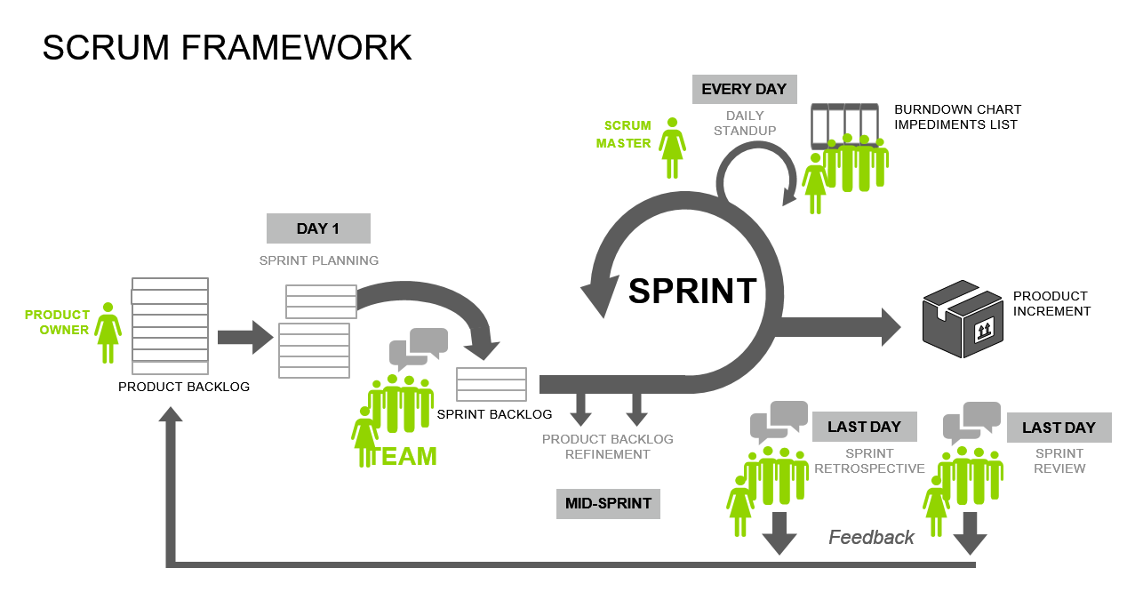

Characteristics of Scrum
Scrum is a set of guiding principles, values and practices that help teams deliver products in short cycles, enabling fast feedback, continual improvement, and rapid adaption to change.
Scrum Framework
Self-Organizing
Cross Functional
Scrum Team Attributes
Traditionally a project manager assigns tasks and directs teams. Self-organizing teams decide how to best accomplish their work.
Traditionally teams are assembled around function. Cross functional teams have members across each competency needed to accomplish the work. Cross functional teams do not have to rely on those outside of their team.

Slide 12
Questions?

Slide 13

Exercise: Check your mindset…

Slide 14

Validate Our Learning and Mindset: Fixed vs. Agile
This activity helps us identify our mindset, mindset means what is our established set of attitudes and habits towards succeeding when there is uncertainty
Attitude that equates failure and problems with opportunities for learning, a belief that we can all improve over time, that our abilities are not fixed but evolve with effort
Believes that basic skills, intelligence, and qualities are inherent and fixed. And those are set from birth. There is not much one can do about it. They don’t see the point of putting the efforts to learn.
Notes:
www.mentimeter.com
Login: Rubina.haddad@canada.ca
Password: playbook
https://www.360pmo.com/fixed-vs-growth-mindset/

Slide 15
Validate Our Learning and Mindset: Fixed vs. Agile
This activity helps us identify our mindset, mindset means what is our established set of attitudes and habits towards succeeding when there is uncertainty
Attitude that equates failure and problems with opportunities for learning, a belief that we can all improve over time, that our abilities are not fixed but evolve with effort
Believes that basic skills, intelligence, and qualities are inherent and fixed. And those are set from birth. There is not much one can do about it. They don’t see the point of putting the efforts to learn.
Assign each behavior to the right mindset
Learn by thinking
Fail fast/small/early
Can be wrong the first time
Don’t change or improve
Learn by doing
Right the first time
Stick to what they know
Desire to look smart
Avoid failure
Embrace challenges
Feedback is personal
Desire continuous learning
Notes:
www.mentimeter.com
Login: Rubina.haddad@canada.ca
Password: playbook
https://www.360pmo.com/fixed-vs-growth-mindset/

Slide 16
Validate Our Learning and Mindset: Fixed vs. Agile
This activity helps us identify our mindset, mindset means what is our established set of attitudes and habits towards succeeding when there is uncertainty
Attitude that equates failure and problems with opportunities for learning, a belief that we can all improve over time, that our abilities are not fixed but evolve with effort
Believes that basic skills, intelligence, and qualities are inherent and fixed. And those are set from birth. There is not much one can do about it. They don’t see the point of putting the efforts to learn.
Assign each behavior to the right mindset
Learn by thinking
Fail fast/small/early
Can be wrong the first time
Don’t change or improve
Learn by doing
Right the first time
Stick to what they know
Desire to look smart
Avoid failure
Embrace challenges
Feedback is personal
Desire continuous learning
Notes:
https://www.360pmo.com/fixed-vs-growth-mindset/

Slide 17
Scrum Roles

Slide 18
Key Responsibilities
Works in collaboration with Program Owners and Program Business Analysts to define epics, MVRs and user stories
Is empowered to make on-the-spot decisions on scope requirements
Owns the user experience and product direction for their platform/application based on department standards and guidelines
Product Owner
Is responsible for the product backlog, story prioritization and acceptable criteria
Acts as the primary business representative for the scrum team to connect business and technology
Product Owner is a long-standing role who is accountable for a Product or group of Products
Key Artifacts
Desired Outcomes
Time-boxed decision making on scope and requirements to keep delivery team going
Creation of value-based MVR, user stories and small / deliverable units of work
Effective, value-based backlog planning and prioritization to ensure a continuous flow of valuable work
Time-boxed Stakeholder Engagement (including business and delivery partners)
Time-boxed issue resolution / impediment removal
User Stories / Epics (acceptance criteria)

Slide 19
Key Responsibilities
Collaborates with the Release Manager and Product Owner to coordinate product delivery
Provides training in new practices and techniques and one-on-one coaching as needed
Facilitates daily stand-ups sessions focusing on impediment removal; facilitates and runs retrospectives
Actively provides advice and lessons learned; proactively helps team improve their ISED agile competencies
Scrum Master
Monitors progress, issues and risks; tracks and socializes discovery and delivery metrics
Assists new technical leads and other team members in facilitating project meetings
Provides initial training to all new team members on ISED’s Digital Playbook
Key Artifacts
Desired Outcomes
Positive overall well-being of team members
Positive team dynamics
Adoption and consistent use of Agile techniques, tools, and standard practices
A continuous flow of work that is constantly being executed
Impediment
Burn Down Chart

Slide 20
Key Responsibilities
Commit to the team working agreement and adhere to the rules outlined
Peer reviews ensuring all team members are adhering to the agreed upon standards and guidelines
Responsible for delivering the agreed upon scope at the end of each sprint
Breakdown user stories / requirements into tasks with completed estimates
Scrum Team
Ensure tasks status are updated in real-time and communicated to the team
Support other team members when called upon
Key Artifacts
Desired Outcomes
Based on team work over time, the team’s velocity should be consistent and predictable
Respect for each other ensuring that all team members have an equal say
Quality work focusing on producing value to the user each sprint
Sprint Backlog
Test Cases

Slide 21
Ceremonies

Slide 22
Workflow
Create User Stories
Plan the Next Steps
Based on the Product Vision, the Product Owner creates the initial Product Backlog
Story Mapping exercise may be required to organize the flow of the user stories
For large backlogs, the Product Owner may organize using Epics and Initiatives
Once the backlog is established (at a high-level) the product owner needs to start planning out the next steps by:
Prioritizing the backlog
Determine what teams and resources are required on each team
Determining the schedule
When will work begin?
What dependencies exist?
What resources are available?
Product Planning
Objective
Create the initial product backlog and determine the number and nature of the scrum teams required to design, validate and deliver a solution. Can also be done for each Epic in a large Product Backlog.
Frequency
Once, prior to the beginning of the first sprint or as needed for large Product Backlogs
Participants
Scrum Artifacts
Duration
Product Owner
Program Business Analysts (as required)
Program Subject Matter Experts (as required)
Technical Subject Matter Experts (as required)
Scrum Master (optional)
Working Agreement
User Stories
Product Backlog
As required.

Slide 23
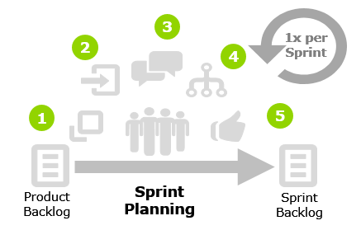
Workflow
Communicate:
Communicate team velocity, capacity and sprint objective
Select
Pull ready user stories into the sprint backlog
Sprint Planning
Clarify
Ensure everyone understands the work being lined up for the sprint, and no major questions are unanswered
Decompose/Estimation
Objective
Break down each user story into a set of sub task to help manage work completion throughout the sprint. Optionally the tasks will be estimated by the scrum team and recorded in Jira
As a team review and confirm which user stories will be committed to the upcoming sprint. Breakdown user stories into discrete sub-tasks. The team establishes a goal for the sprint.
Align
Do a final review and ensure all team members are on board with committing to the sprint backlog
Frequency
This ceremony will happen once at the beginning of each sprint. This is the first activity that occurs in each sprint.
Participants
Artifacts
Duration
Product Owner
Scrum Master
All Scrum Team Members
Sprint Backlog
User Stories
As required.

Slide 24
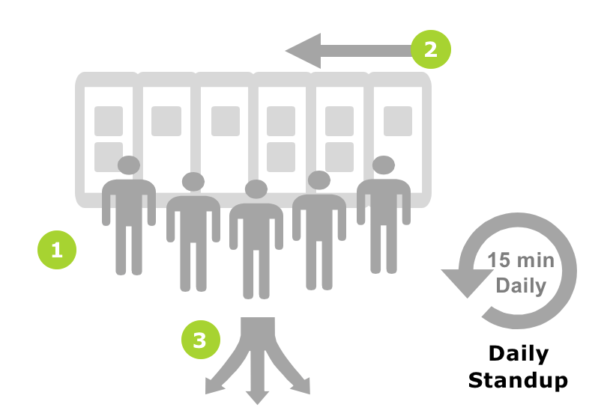
Workflow
Meet
Clarify
The team meets at a set time and place each day for 15 minutes to plan the work for the next 24 hours (ideally around the Kanban board)
Each team member discussing the following 3 points;
What I worked on since the last stand up
What I am working on next
What are my impediments or blockers
The team leaves the meeting knowing what they need to do, what the team objectives are, how they can help the team, and how their impediments are going to get solved
Team Standup
Manage
Objective
Scrum master will discuss the burndown chart with the team to help identify any issues;
If the burndown is trending slow the team will need to discuss why this is happening. Impediments? Clarity?
The scrum master will address the impediments and confirm a plan for how they will help remove them
To determine a plan to move each work item forward, including actions to resolve any impediments or blocker.
Frequency
Daily or as agreed to in the team Working Agreement.
Participants
Artifacts
Duration
Scrum Master
Scrum Team
Impediments
10-15 minutes.

Slide 25
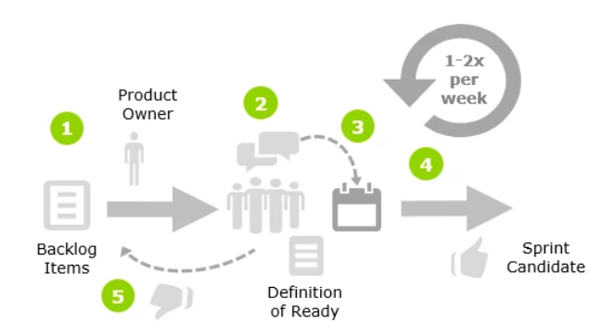
Workflow
Prepare
Revise
The Product Owner prepares and prioritizes a set of User Stories from the Product Backlog to be reviewed by the team in order to ready them for the next few sprints
The Product Owner takes any actions identified to revise and update the Product Backlog
Surface
The Product Owner presents the User Story while the team discusses it and identifies any assumptions or clarifications necessary for the User Story to meet the Definition of Ready
Product Backlog Refinement
Focus
As user stories are refined, added to the backlog and removed from the backlog, the release plan is also adjusted. As part of the backlog grooming session we must review the current release plan and update accordingly
Objective
Estimate
Review user stories in the product backlog to ensure the backlog contains the appropriate items, that the user stories have sufficient enough detail to estimate, that they are prioritized, and that the items at the top of the backlog are getting closer to the definition of ready. This exercise gives the team a "heads up" on upcoming user stories and allows them to ask questions and confirm their understanding of the user stories.
User Stories without major assumptions or clarifications required are sized and prioritized by the team.
Participants
Artifacts
Frequency
Scrum Master
Product Owner
Program Owner
Scrum Team
Product Backlog
At minimum this should take place at least once per sprint. However, it can occur more than once if needed.
Duration
30 – 120 minutes.

Slide 26
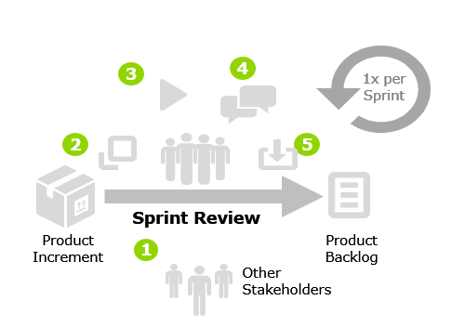
Workflow
Invite
Invite key stakeholders to the ceremony
Frame
Review completed work, user story by user story
Demonstrate
Sprint Review
Show how each of the acceptance criteria is met for each user story
Get Feedback
Collect the response from the participants on the work demonstrated
Objective
Incorporate
Demo the user stories allocated to the existing sprint with a clear focus on the acceptance criteria for each user story. The Product Owner must validate the completed work. The velocity and project backlog are updated.
Take the feedback (enhancements, changes, etc.) and incorporate it into the Product Backlog for future Sprints or make the changes in the current Sprint if requests / changes are minor
Frequency
This ceremony happens once at the end of each sprint.
Participants
Artifacts
Product Owner
Scrum Master
Scrum Team
Program Stakeholders
Refined Product Backlog
Duration
30 – 120 minutes depending on the scope and complexity of the sprint.

Slide 27
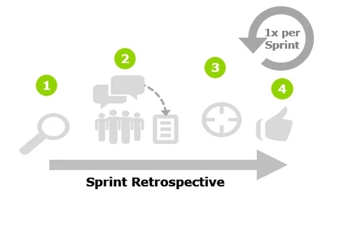
Workflow
Prepare
Identify a theme or Retrospective type to help focus the conversation on areas needing improvement. There are a number of different Techniques that can be used to facilitate the retrospective meeting to help generate different thinking patterns from the participants
Sprint Retrospective
Surface
Bring the full team together and surface as many improvement items as possible around the Retrospective theme as well as the activities that should continue
Focus
Objective
Find a way to quickly focus the conversation around one or two items raised and develop an action plan around them (try grouping items by theme, dot voting, etc. to find focus areas)
Openly and respectfully discuss what went well as well as where there are areas of potential improvement for the team based on the sprint that was just completed. The results of this meeting could include an action plan on how to implement the improvement areas discussed and how to continue the activities that worked well.
Improve
Work as a team to execute the action plan in the next Sprint and continuously improve.
Frequency
This ceremony happens once at the end of each sprint.
Participants
Artifacts
Product Owner
Scrum Master
Scrum Team
Group Feedback / Action Plan
Retrospective Template
Duration
Approximately 60 minutes

Slide 28
Questions?

Slide 29
Scrum Artifacts

Slide 30
A Documented Agreement for the Project Team to Set Ground Rules
A working agreement establishes rules and disciplines that all Scrum Team Members agree to adhere to throughout the entire process. Team members should hold each other accountable through the entire process and can use the Sprint Retrospective to reflect on the agreement and update if necessary.
Working Agreement
Working Agreement Examples
A list of scrum team members, the time they have allocated to the project, the team member’s roles and responsibilities
When will the product owner be available and through which channels
What is the DoR for user stories
What is the DoD for user stories
What ceremonies will be held, and where and when they will take place
What artifacts will be created, and how they will be shared with team
What tools and processes will be used to manage the user stories, bugs, impediments, etc.
The team’s goals/activities if required

Slide 31
A Short Description of a User Based on User Research That Helps the Team Make Decisions
A user story is a short description of the product functionality, and is written from the perspective of the user.
Each User Story should be independent of each other, meaning exact functionality should not overlap in other user stories. Each User Story should follow a specific and repeatable format to ensure consistency.
User Story
Guiding Principles (INVEST)
User Story Structure
Independent - A story is structured to minimize dependencies
Negotiable - A story allows further refinement of scope to provide options around timing and cost
Valuable - A story has concrete business value or an inherent investment value
Estimable - A story has sufficient definition to enable coarse estimation
Small - A story is small enough to be completed within a sprint
Testable - A story is testable by itself and has clear acceptance criteria associated with it
As a <type of user>
I want <users goal>
So that <some reason>
Example:
As a power user
I want the ability to merge all user records by selecting which values from each I want to keep
So that the application does not contain duplicates

Slide 32
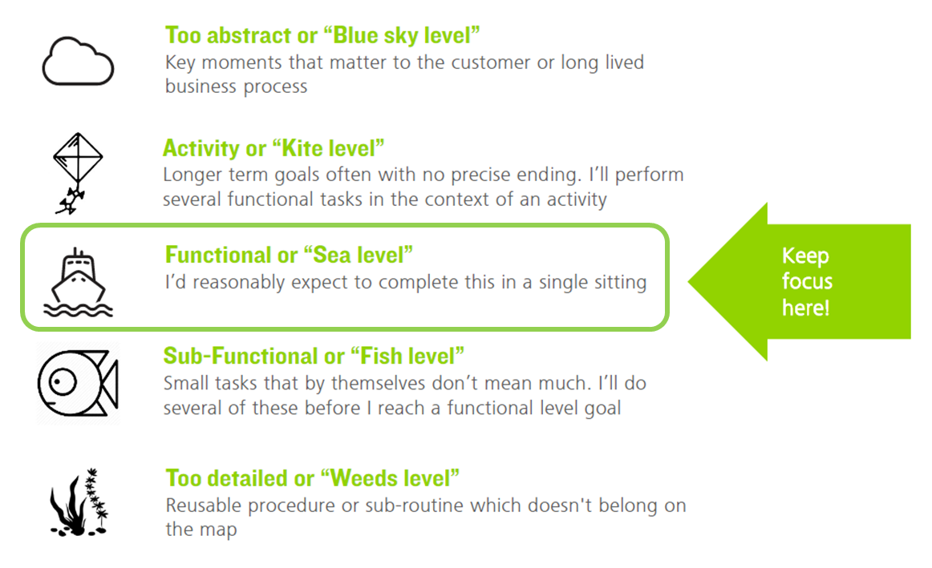

Slide 33
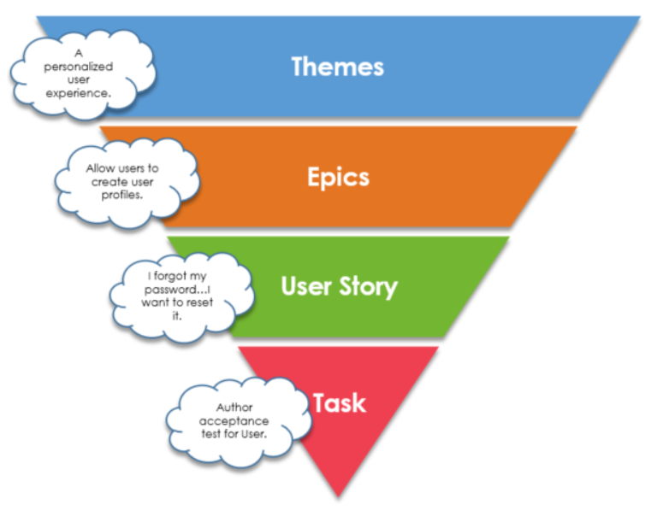
Themes
This Is The Entire Backlog of User Stories and Bugs for Your Product
A Theme is a top-level objective that may span projects and products, and it may be broken down into sub-themes. At its most granular form, a Theme may be an Epic.
The product backlog consist of all the user stories that make the functionality for the entire product that is being built
The product backlog is broken down into consumable components (Themes, Epics, User Stories, and Task)
The owner of the product backlog is the product owner.
Epics
An Agile Epic is a group of related User Stories, representing a feature.
Product Backlog
User Story
Product Backlog Characteristics
A User Story is a description of desired functionality told from the perspective of the user.
Items added to the product backlog must add value for the end user
Items in the product backlog are prioritized and ordered by the product owner
The backlog is a living document
All items added to the product backlog are estimated
Items can have different levels of detail
The backlog is not guaranteed to be fully depleted by the end of the project as a budget is estimated up front when the backlog has not been fully fleshed out
Task
Tasks are individual activities that are required for a User Story to be “done”.

Slide 34
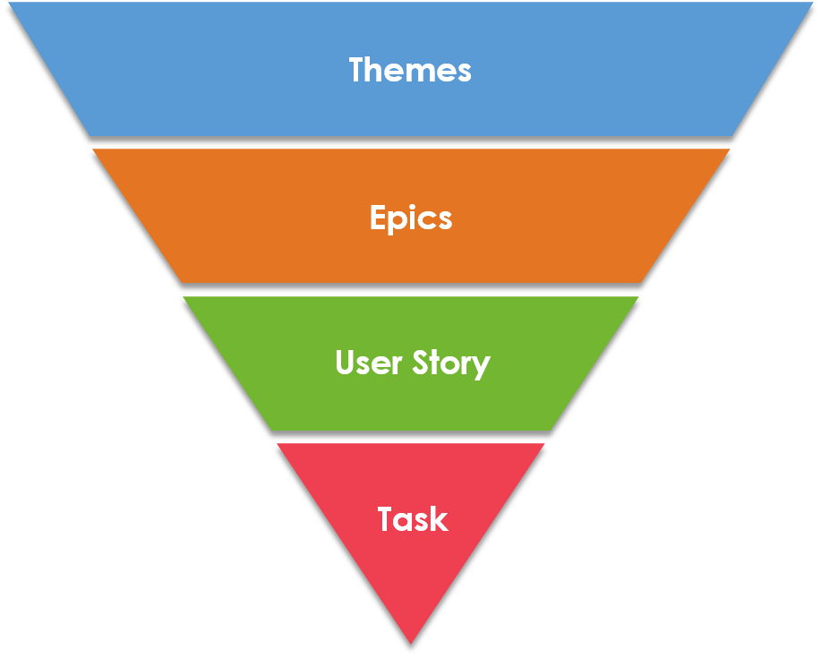
This is a List of Tickets Your Team Has Committed to doing for The Current Sprint
It is important to note that the user stories from the product backlog that are being proposed for the next sprint come from the product owner!
Creating a Sprint Backlog
Sprint Backlog
The Sprint Backlog is formulated during Sprint Planning
The Scrum Team works with the Product Owner and Business Analyst to break User Stories into smaller tasks and estimate the length of time it will take to complete each task
At the end of the Sprint Planning meeting, the Sprint Backlog will be set
Key Considerations
Prioritized Sprint Backlog
1
User Story
During the sprint the Product Owner should not alter the Sprint Backlog
Once committed to the Sprint Backlog, the Scrum Team is responsible for completing those User Stories
If you must change the Sprint Backlog during the sprint, you may have to end the sprint and begin over again from a Sprint Planning session
2
User Story
3
User Story
4
User Story
5
User Story
6
User Story

Slide 35
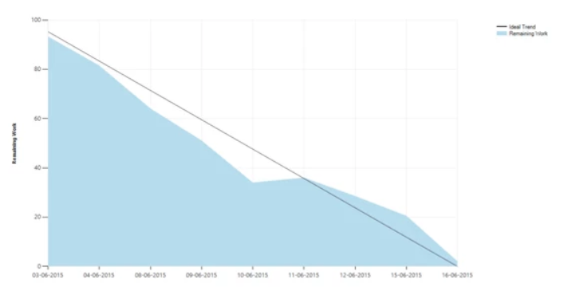
Track sprint, EPIC, and release Burndown to see if the team is on track or behind schedule
Key Factors
A Burndown Chart illustrates the amount of work that is remaining or still needs to be completed within a specific time frame.
Burndown Chart
The outstanding work (or backlog) is represented on the vertical axis, with time along the horizontal.
It’s extremely useful in predicting when all of the work will be completed & allows project leadership to identify troublesome delivery trends early on.
This is a great tool for the Scrum Master to use to understand which way the sprint is trending. It allows the team to react / pivot early in the sprint if it realizes the work is behind schedule.
The primary focus for the Scrum Master is to remove impediments for the team to allow them to keep working and this tool highlights impediments
The Burndown chart should be assessed daily with the team to review what impediments are causing the Burndown to go off track and which items are causing the Burndown to be ahead of schedule
It is important that the Scrum Team buys into the habit of updating the time remaining on their tasks as this is reflected on the Burndown chart

Slide 36
An impediment is a roadblock or hindrance that is keeping the team from making progress during the sprint
These items are also referred to as blockers and are to be brought to the attention of the scrum master and scrum team during the daily stand up meeting.
Impediment
Working With Impediments
The list of impediments is maintained and managed by the Scrum Master
The Scrum Master is responsible for resolving impediments allowing the team to concentrate on the work allocated to the sprint
The Scrum Master is charged with ensuring the impediment list is visible to the team and updated once an impediment is cleared
Impediments can be raised by team members during daily standup meetings or directly to the Product Owner or Scrum Master
Scrum Masters should always keep an eye out for issues that stop progress, and quickly involve the right individuals to remove impediments
If the Scrum Master cannot remove an Impediment within a day, then he/she should update the scrum team and update the resolution plan. An impediment resolution plan should be put in place to ensure that the client is also committed to helping get the impediments resolved as soon as possible
The Impediment removal hierarchical process starts with the team, and then it is taken up in the Scrum of scrums and eventually the program level if it remains unresolved

Slide 37
Portfolio Management

Slide 38


Workflow
Meet
Product Owners from other scrum teams meet at a set time and place each day or as agreed upon to discuss each teams accomplishments, future work, team dependencies, and impediments that affect each other.
Meeting attendees should be nominated by the team. Ideally the team ambassador should be of a technical nature (developer, database administrator, tester, etc.), but this really depends on the issues being faced by the team.
The team member should be able to represent the team and speak to the current work being completed, future work, and impediments.
Scrum of Scrums
Manage
Objective
Discuss dependent work items and impediments to fully understand the dependencies and a plan on how to resolve impediments.
To facilitate effective integration, coordination, and collaboration among scrum teams
Clarify
The team leaves the meeting knowing the current status of each team, the direction each of each team moving forward, and clear picture and plan on dependent work being done, and an action plan on how impediments are going to be resolved.
Frequency
Daily or as agreed to in the team Working Agreement.
Participants
Artifacts
Duration
Scrum Master
Product Owners
Scrum Team Ambassadors
Impediments
Action Plan
15-30 minutes depending on the frequency of the meeting.

Slide 39
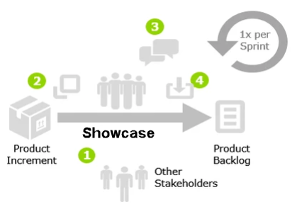
Workflow
Invite
Invite key stakeholders to the ceremony.
Frame
Review completed work, team by team.
Get Feedback
Showcase
Collect the response from the participants on the work demonstrated.
Incorporate
Take the feedback (enhancements, changes, etc.) and incorporate it into the Product Backlog for future Sprints or make the changes in the current Sprint if requests / changes are minor.
Objective
During the showcase ceremony each team demos the work/iteration they have successfully completed, based on the user stories allocated during the existing sprint.
Frequency
The ceremony happens once at the end of the sprint.
Participants
Artifacts
Duration
Scrum Masters
Product Owners
Scrum Team Ambassadors
Program Stakeholders
Refined backlog
30-60 minutes.

Slide 40
Workflow
Communicate:
Each Product Owner clearly describes their product and the vision and how it aligns to the overall program strategic vision.
Map Epics
Break down each team’s high-level Epics.
Integrated Product Planning
Commonality
Identify common elements, dependencies and risks.
Coordinate Planning
Objective
Discuss functionality of each product that are dependent upon other products; coordinate the overall work and process across the program.
As a team review and identify commonalities, dependencies, and risks, between projects and ensure that the overall objectives are aligned to the same strategic vision.
Project Planning
Program Vision
Program Review
Review
Do a final review of team plans to identify any issues with scope, team availability, constraints and dependencies.
Frequency
This ceremony will happen once at the beginning of each sprint. This is the first activity that occurs in each sprint.
Participants
Artifacts
Duration
Product Owner
Scrum Master
Scrum Team Ambassadors
Subject Matter Experts as required
….
As required.

Slide 41
Exercise: Scrum roles and responsibilities

Slide 42


Slide 43
The Scrum Structure
Strategic
Vision
Program
Owner
Business
Objectives
Remove
Impediments
Remove
Impediments
Subject Matter
Experts
Scrum
Master
Product
Owner
Stakeholders
Scrum
Team
Implements &
Delivers

